Slide 1
Chapter 3
Architecture Styles (Pipe and Filter, Event-based, Layered etc.) and Architectural View Models)

Slide 2
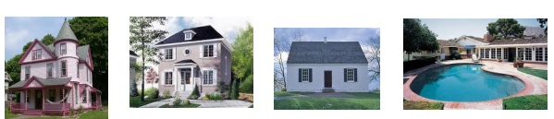
Outline
What is Architecture and architect role
Architecture Patterns
Pipe and filter
Event-based
Layered etc.
Architectural view models

Slide 3

What is Software Architecture?
The architecture of a system consists of:
The structure(s) of its parts
Including design-time, test-time, and run-time hardware and software parts
The externally visible properties of those parts
modules, hardware units
The relationships and constraints between them
Architecture is the fundamental organization of a system, embodied in its components, their relationships to each other and the environment, and the principles governing its design and evolution.
Architecture is:
All about communication
What ‘parts’ are there?
How do the ‘parts’ fit together?
Architecture is Not:
About development
About algorithms
About data structures

Slide 4


Other Definitions of Software Architecture
Architecture is high-level design.
Architecture is the overall structure of the system.
Architecture is a set of principal design decisions about a software system
Architecture is the structure of the components of a program or system, their interrelationships, and the principles and guidelines governing their design and evolution over time.
Architecture is components and connectors
Note: Almost all of the above definitions focus on reasoning about the structural system issue.

Slide 5
Fundamental concepts of Architecture
Three fundamental understandings of software architecture.
Every application has an architecture.
Every application has at least one architect.
Architecture is not a phase of development.
Note: Architecture is a design, but every design is not an architecture.

Slide 6
Architecture-Centric Design
Traditional design phase suggests translating the requirements into algorithms, so a programmer can implement them
Architecture-centric design includes the following considerations:
Stakeholder issues
Decision about use of COTS component
Overarching style and structure
Package and primary class structure
Deployment issues
Post implementation/post deployment issues

Slide 7
Software Architecture (cont’d)
A software architecture defines:
The components of the software system
How the components use each other’s functionality and data
How control is managed between the components
Software architecture is the blueprint for a software system’s construction and evolution
Architecture = {components, connectors, constraints}

Slide 8
Components
A software component is an architectural entity that :
Encapsulates a subset of the system’s functionality and/or data
Restricts access to that subset via an explicitly defined interface
Has explicitly defined dependencies on its required execution context
Components typically provide application-specific services.
Types of components
computational: does a computation of some sort. E.g. function, filter .
memory: maintains a collection of persistent data. E.g. data base, file system, symbol table.
manager: contains state + operations. State is retained between invocations of operations. E.g. server.
controller: governs time sequence of events. E.g. control module, scheduler .

Slide 9
Connectors
A software connector is an architectural building block ,regulating interactions among components.
In many software systems, connectors are usually simple procedure calls or shared data accesses
Much more sophisticated and complex connectors are possible!
Connectors typically provide application-independent interaction facilities.

Slide 10
Configuration/Topology
Components and connectors are composed in a specific way in a given system’s architecture to accomplish that system’s objective.
An architectural configuration/topology, is a set of specific associations between the components and connectors of a software system’s architecture

Slide 11
Prescriptive vs. Descriptive Architecture
A system’s prescriptive architecture captures the design decisions made prior to the system’s construction.
It is the as-conceived or as-intended architecture
A system’s descriptive architecture describes how the system has been built
It is the as-implemented or as-realized architecture

Slide 12
Domain Specific Software Architecture
Domain-specific software architectures (DSSAs):
Specialized for a particular task (domain).
Generalized for effective use in that domain.
Composed using a standardized topology.
Key benefit:
maximal reuse of knowledge.
Key drawback:
only applicable in specific domain.

Slide 13
Why Software Architecture is Important
Communication among stakeholders
Each stakeholder (customer, user, project manager, coder, tester and so on) of a system is concerned about different characteristics of the system that will be affected by the architecture.
A user is concerned that the system is reliable and available when needed; The customer is concerned that the architecture can be implemented on schedule and within budget;
The manager is worried (as well as about cost and schedule) that the architecture will allow teams to work largely independently, interacting in disciplined and controlled ways.
The software architect is worried about strategies to achieve all of those goals.
Architecture provides a common language in which different concerns can be expressed, negotiated, and resolved at a highly intellectually manageable level.

Slide 14
Why Software Architecture is Important
2) It helps to make early design decisions :
Software architecture manifests the earliest design decisions about a system, which influence the system's remaining development, its deployment, and its maintenance life.
The architecture defines constraints on implementation
The architecture dictates organizational structure
The architecture inhibits or enables a system's quality attributes e.g. If your system requires high performance, you need to manage the time based behavior of elements and the frequency and volume of inter-element communication
Predicting system qualities by studying the architecture
The architecture enables more accurate cost and schedule estimates

Slide 15
Why Software Architecture is Important…
3) It provides a transferable, re-usable model
Software architecture constitutes a relatively small, intellectually graspable model for how a system is structured and how its elements work together, and this model is transferable across systems.
In particular, it can be applied to other systems exhibiting similar quality attribute and functional requirements and can promote large-scale reuse.
Systems can be built using large, externally developed elements
An architecture permits template-based development
An architecture can be the basis for training

Slide 16
Role of Software Architect
Convert customer requirements into a technical design
Lead the problem domain analysis team
Ensure that the technical design meets quality requirement
Perform continuous risk assessment, develop risk mitigation strategies
Perform early prototyping aimed at mitigating major risks
Communicate with stakeholders through detailed technical presentations
Listen to stakeholders and build consensus
Review developer code and ensure conformance to the architecture and good coding practices
Serve as a mentor for analysts, designers, and developers

Slide 17
Architectural Design Process
System structuring and partitioning
Decomposition of software system into sub-systems and communications between sub-systems
Sub-system is an independent system from other sub-systems.
Decomposition of sub-system into modules or components
Component (module) provides services to other component.
Reuse component

Slide 18
Sub-systems, Modules and Components
A sub-system is a system in its own right whose operation is independent of the services provided by other sub-systems.
A module is a system component that provides services to other components but would not normally be considered as a separate system.
A component is an independently deliverable unit of software that encapsulates its design and implementation and offers interfaces to the out-side, by which it may be composed with other components to form a larger whole.

Slide 19
Architecture Style
Set of rules, constraints, or patterns of how to structure a system into a set of components and connectors.
An architectural style defines a family of systems in terms of a pattern of structural organization. More specifically, an architectural style defines a vocabulary of components and connector types, and a set of constraints on how they can be combined.

Slide 20
Types of Architectural Styles
Pipes-and-Filter
Client-Server
Peer-to-Peer
Event Based
Layering
MVC
SOA (Service Oriented Architecture)

Slide 21
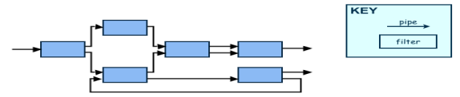
Pipes-and-Filter
The system has – Streams of data (pipe) for input and output – Transformation of the data (filter)
"The Pipes and Filters architectural pattern provides a structure for systems that process a stream of data. Each processing step is encapsulated in a filter component. Data are passed through pipes between adjacent filters. Recombining filters allows you to build families of related filters."

Slide 22
Cont’d
P&F architecture consist of producer/consumer subsystems each subsystem may produce, consume, or consume/produce data and connectors (pipes) to forward the data from one filter to another involving transformation on streams of data.
Implementation steps:
Divide the functionality of the problem into a sequence of processing steps.
Define the type and format of the data to be passed along each pipe.
Determine how to implement each pipe connection.
Design and implement the filters. Note: The design of a filter is based on the nature of the task to be performed and the natures of the pipes to which it can be connected.

Slide 23
Cont’d
Several important properties – The designer can understand the entire system's effect on input and output as the composition of the filters – The filters can be reused easily on other systems – System evolution is simple
Drawbacks – Not good for handling interactive application – Duplication in filters functions

Slide 24
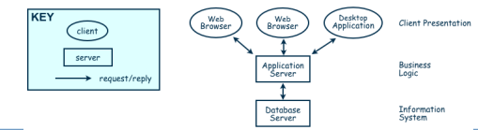
Client-Server
A client-server architecture distributes application logic and services respectively to a number of client and server subsystems, each potentially running on a different machine and communicating through the network (e.g. by RPC).
Two types of components: – Server components offer services(Response/Reply) – Clients sends request and receive response from server.
Client may send the server a request and server reply a response to the request. It is a kind of request and response/reply mechanism.

Slide 25
Cont’d
Advantages
Distribution of data is straightforward
Makes effective use of networked systems.
May require cheaper hardware
Easy to add new servers or upgrade existing servers
Disadvantages
Redundant management in each server
May require a central registry of names and services - it may be hard to find out what servers and services are available

Slide 26
Peer-to-Peer (P2P)
Each component acts as its own process and acts as both a client and a server to other peer components.
Any component can initiate a request to any other peer component.
Characteristics – Scale up well – Increased system capabilities – Peers are distributed in a network, can be heterogeneous, and mutually independent. – Robust in face of independent failures. Highly scalable – This differs from client/server architectures, in which some computers are dedicated to serving the others. – Components do not offer the same performance under heavy loads.

Slide 27
Event-Based Architecture
Components interact by broadcasting and reacting to events – Component expresses interest in an event by subscribing to it – When another component announces (publishes) that event has taken place, subscribing components are notified – Implicit invocation is a common form of publish-subscribe architecture • Registering: subscribing component associates one of its procedures with each event of interest (called the procedure)
Characteristics – Strong support for evolution and customization – Easy to reuse components in other event-driven systems – Difficult to test

Slide 28
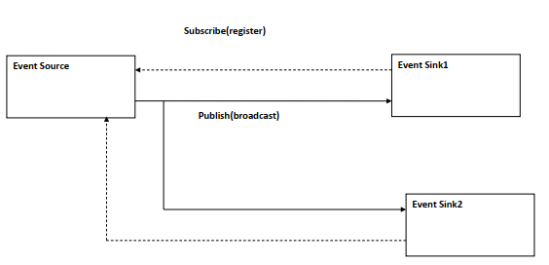
Cont’d
In broadcast models an event is broadcast to all sub-systems. Any sub-system which can handle the event may do so.

Slide 29
Layering
Layers are hierarchical
Each layer provides service to the one outside it and acts as a client to the layer inside it
Layer bridging: allowing a layer to access the services of layers below its lower neighbor
Each layer has two interfaces.
Upper interface provides services and Lower interface requires services.
The design includes protocols
Explain how each pair of layers will interact
Advantages
High levels of abstraction
Relatively easy to add and modify a layer
Disadvantages
Not always easy to structure system layers
System performance may suffer from the extra coordination among layers

Slide 30
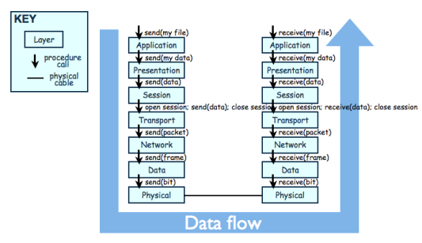
cont’d
The OSI model

Slide 31
MVC (Model-View-Controller)
In the MVC paradigm, the user input, the modeling of the external world, and the visual feedback to the user are explicitly separated and handled by three types of objects, each specialized for its task.
The view manages the graphical and/or textual output to the portion of the bitmapped display that is allocated to its application.
The controller interprets the mouse and keyboard inputs from the user, commanding the model and/or the view to change as appropriate.
The model manages the behavior and data of the application domain, responds to requests for information about its state (usually from the view), and responds to instructions to change state (usually from the controller).

Slide 32
MVC ….
The MVC paradigm is a way of breaking an application, or even just a piece of an application's interface, into three parts: the model, the view, and the controller.
MVC was originally developed to map the traditional input, processing, output roles into the GUI system:
Input → Processing → Output Controller → Model → View

Slide 33
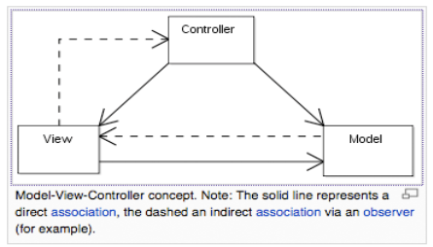
Cont’d
The pattern isolates business logic from input and presentation, permitting independent development, testing and maintenance of each.

Slide 34
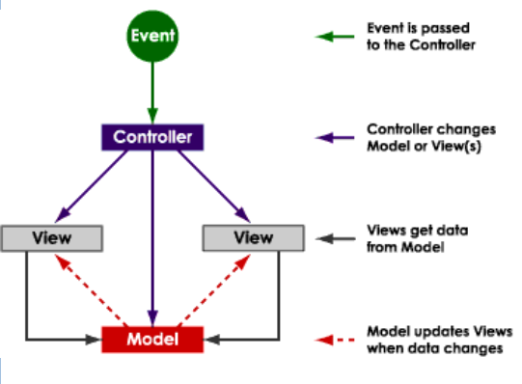
MVC benefits
Clarity of design – easier to implement and maintain
Modularity – changes to one don't affect the others – can develop in parallel once you have the interfaces

Slide 35
Summary (MVC)
The intent of MVC is to keep neatly separate objects into one of tree categories
Model
The data, the business logic, rules, strategies, and so on
View
Displays the model and usually has components that allows user to edit change the model
Controller
Allows data to flow between the view and the model
The controller mediates between the view and model

Slide 36
Combining Architectural Styles
Actual software architectures rarely based on purely one style
Architectural styles can be combined in several ways
Use different styles at different layers (e.g., overall client-server architecture with server component decomposed into layers)
Use mixture of styles to model different components or types of interaction (e.g., client components interact with one another using publish-subscribe communications
If architecture is expressed as collection of models, documentation must be created to show relation between models

Slide 37
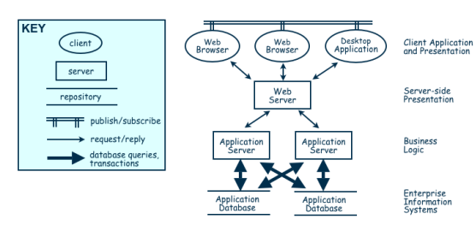
Combination of Event-based, Client-Server, and Repository Architecture Styles

Slide 38
Architectural view models
Architecture documents do not address the concerns of all stakeholders .
Different Stakeholders : end-user, system engineers, developers, clients, architects and project managers.
Architecture documents contained complex diagrams, some times they are hard to be represented on the documentation.
Using different notations for several Views, each one addressing specific set for concerns. Using “4+1” view model

Slide 39
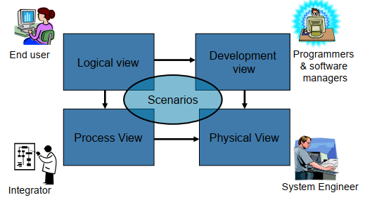
4+1 View Model of Architecture

Slide 40
Thank You !

